Slide 1
軟體工程設計 W4
許庭瑋、陳君翰、洪世彬、劉玠均、楊昕叡、林俊佑
2023/10/12

Slide 2
Homework 4

Slide 3
Homework 4
Page 2 - 1 題
Page 3, 4 - 11 題
Page 5 - 1 題
A person has a name, address, and social security number. A person may charge time to projects and earn a salary. A company has a name, address, phone number, and primary product. A company hires and fires persons. Person and Company have a many-to-many relationship.
There are two types of persons: workers and managers. Each worker works on many projects; each manager is responsible for many projects. A project is staffed by many workers and exactly one manager. Each project has a name, budget, and internal priority for securing resources.
A company is composed of multiple departments; each department within a company is uniquely identified by its name. A department usually, but not always, has a manager. Most managers manage a department; a few managers are not assigned to any department. Each department manufactures many products; while each product is made by exactly one department. A product has a name, cost, and weight.

Slide 4
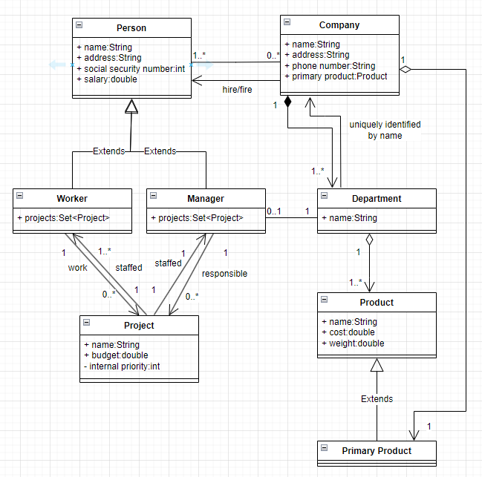
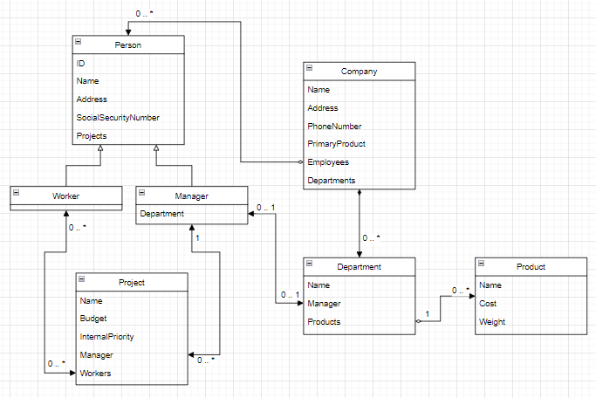
Homework 4:
Notes:
Person ＆project 的關係
三個敘述分開畫
uniquely identified by name可用 qualifier表達
(data structure, map 也 ok 但 qualifier 更好)

Slide 5
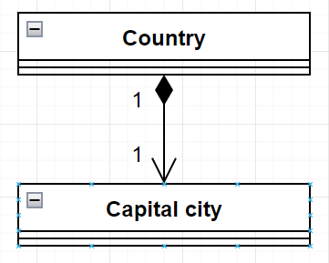


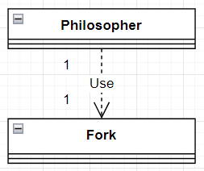
Homework 4:
(1) A country has a capital city.
(3) Files contains records.
(2) A dining philosopher is using a fork.
Notes:
只要能唬爛那怎麼畫都ok

Slide 6
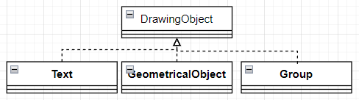
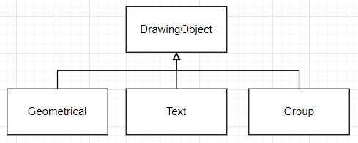
Homework 4:
(4) A drawing object is text, a geometrical object, or a group.

Slide 7

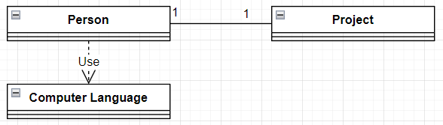
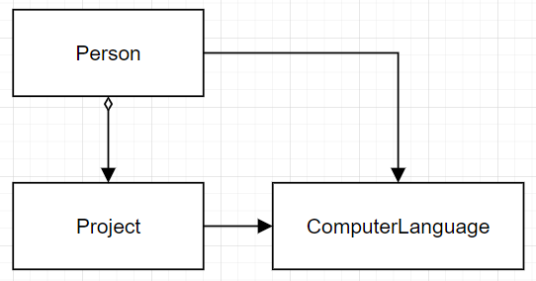
Homework 4:
(5) A polygon is composed of an ordered set of points.
(6) A person uses a computer language on a project.
Notes:
is composed of (語意固定) -> composition
P6. use (3-ary 關係 第一組)

Slide 8
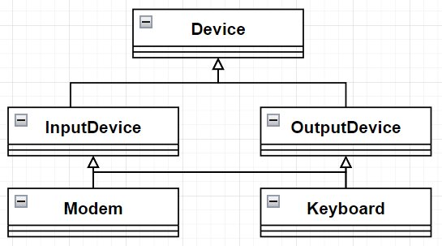
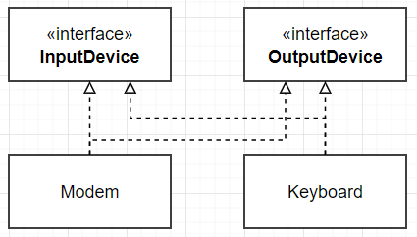
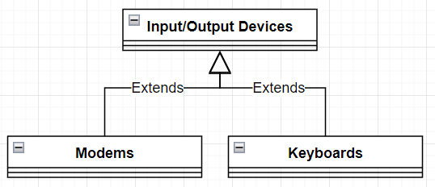
Homework 4:
(7) Modems and keyboards are input/output devices.

Slide 9
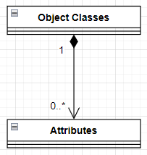

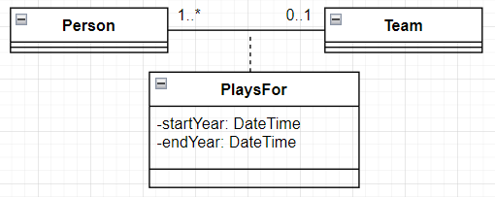

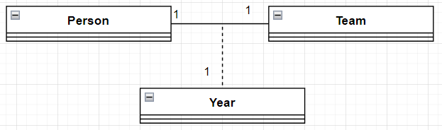
Homework 4:
(8) Object classes may have several attributes.
(9) A person plays for a team in certain year.

Slide 10



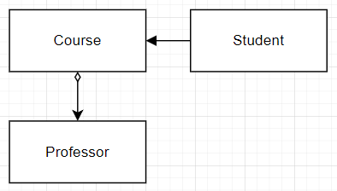
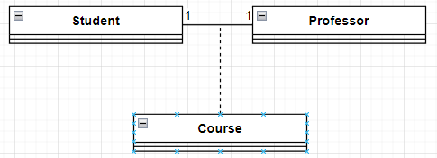
Homework 4:
(10) A route connects two cities.
(11) A students takes a course from a professor.
Notes:
P10 follow-up question: A person marries a person
10.解答: city自己用association連自己，中間用route當association class

Slide 11
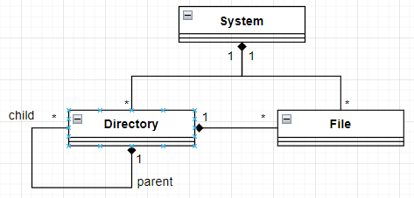
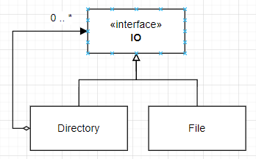
Homework 4:
File System:
Create an application to simulate the Windows/UNIX file system. The file system consists mainly of two types of components — directories and files.
⦁ Directories can be made up of other directories or files, whereas files cannot contain any other file system component.
⦁ In this aspect, directories act as nonterminal nodes and files act as terminal nodes of a tree structure.

Slide 12
A hospital has a large number of registered physicians.
Patients are admitted to the hospital by physicians.
Any patient who is admitted must have exactly one admitting physician.
A physician may optionally admit any number of patients. Once admitted, a given patient must be treated by at least one physician.
A particular physician may treat any number of patients, or he or she may not treat any patients.
Whenever a patient is treated by a physician, the hospital wishes to record the details of the treatment by including the date, time and results of the treatment

Slide 13
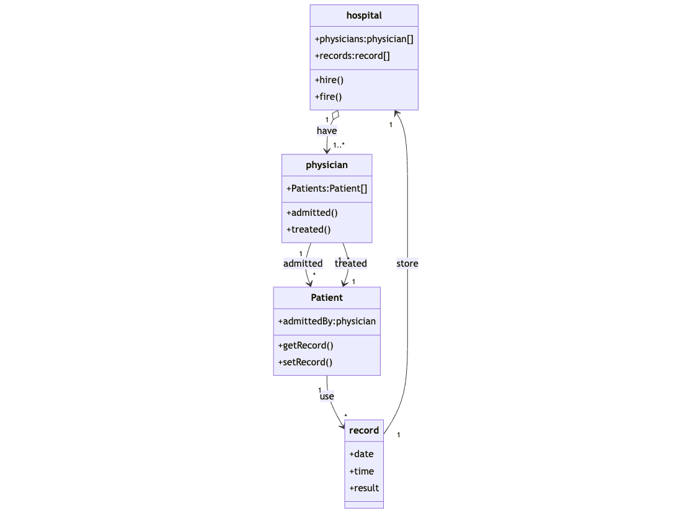
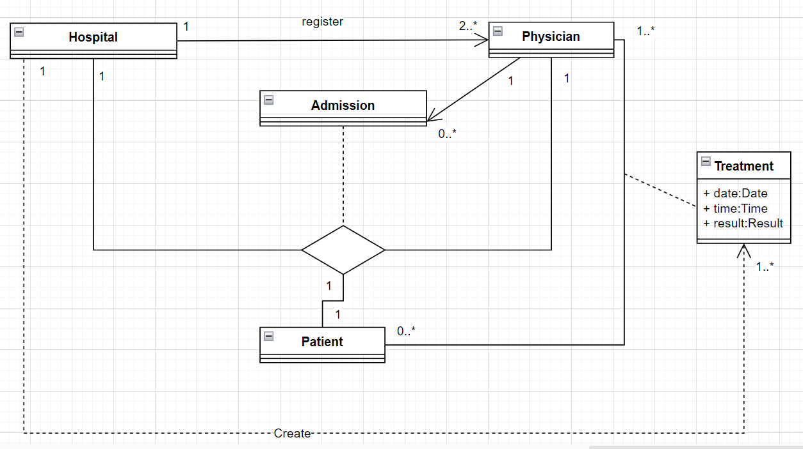
Homework 5:
A hospital has a large number of registered physicians.
Patients are admitted to the hospital by physicians.
Any patient who is admitted must have exactly one admitting physician.
A physician may optionally admit any number of patients. Once admitted, a given patient must be treated by at least one physician.
A particular physician may treat any number of patients, or he or she may not treat any patients.
Whenever a patient is treated by a physician, the hospital wishes to record the details of the treatment by including the date, time and results of the treatment

Slide 14
Homework 5:
A hospital has a large number of registered physicians.
Patients are admitted to the hospital by physicians.
Any patient who is admitted must have exactly one admitting physician.
A physician may optionally admit any number of patients. Once admitted, a given patient must be treated by at least one physician.
A particular physician may treat any number of patients, or he or she may not treat any patients.
Whenever a patient is treated by a physician, the hospital wishes to record the details of the treatment by including the date, time and results of the treatment

Slide 15
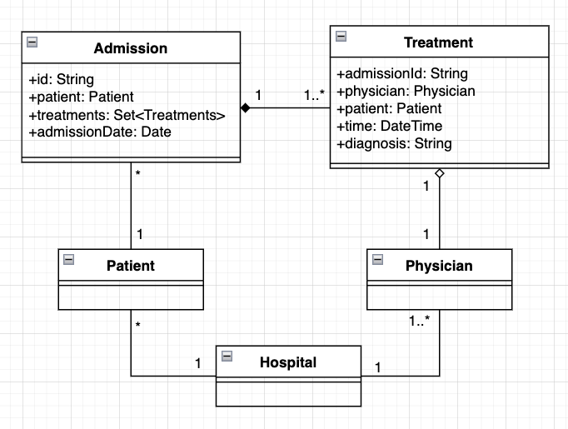
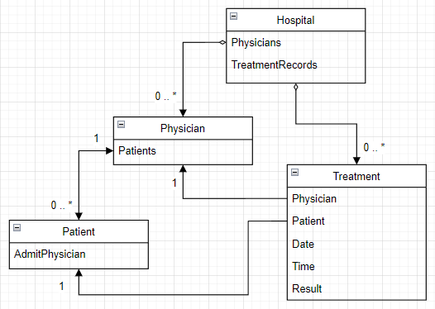
Homework 5:
Notes:
registered physician ??

Slide 16
Code Tracing

Slide 17
Weekly Code Tracing Progress
 | Part | LOC
spring-core-core
許庭瑋 | AbstractFileResolvingResource.java, ClassPathResource.java, UrlResource.java | 543
楊昕叡 | annotation:AnnotationsScanner.java, AttributeMethods.java | 599
劉玠均 | ConvertingComparator<S, T>, DefaultConversionService, 8 default converters | 533
洪世彬 | org.springframework.core.codec | 626
spring-core-aot, spring-core-cglib
陳君翰 | aot.generate | 526
林俊佑 | cglib.proxy (partial) | 622

Slide 18
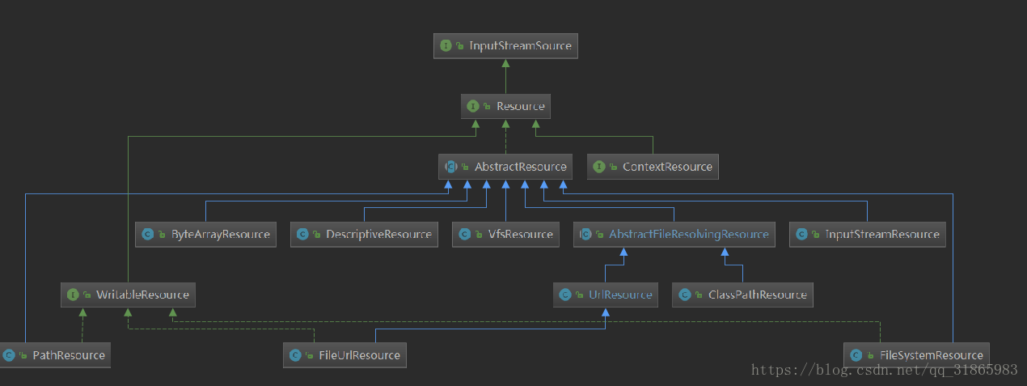
許庭瑋 ( my version)

Slide 19
許庭瑋
AbstractFileResolvingResource
provide abstract resource for internet(url, uri) and local files(jar, vfs, files..)
Override almost all of the functions in AbstrctResource and provide customizeConnection function.
ClassPathResource
provide resource class to get resource from class or classloader
use functions in StringUtils to deal with path name, and use getResourceAsStream to get resource
UrlResource
provide resource class to get resource from URL and URI
use url.openConnection to get resource and override some functions for uri and url class
Notes:
ConvertingComparator<S, T>, DefaultConversionService, 8 default converters

Slide 20
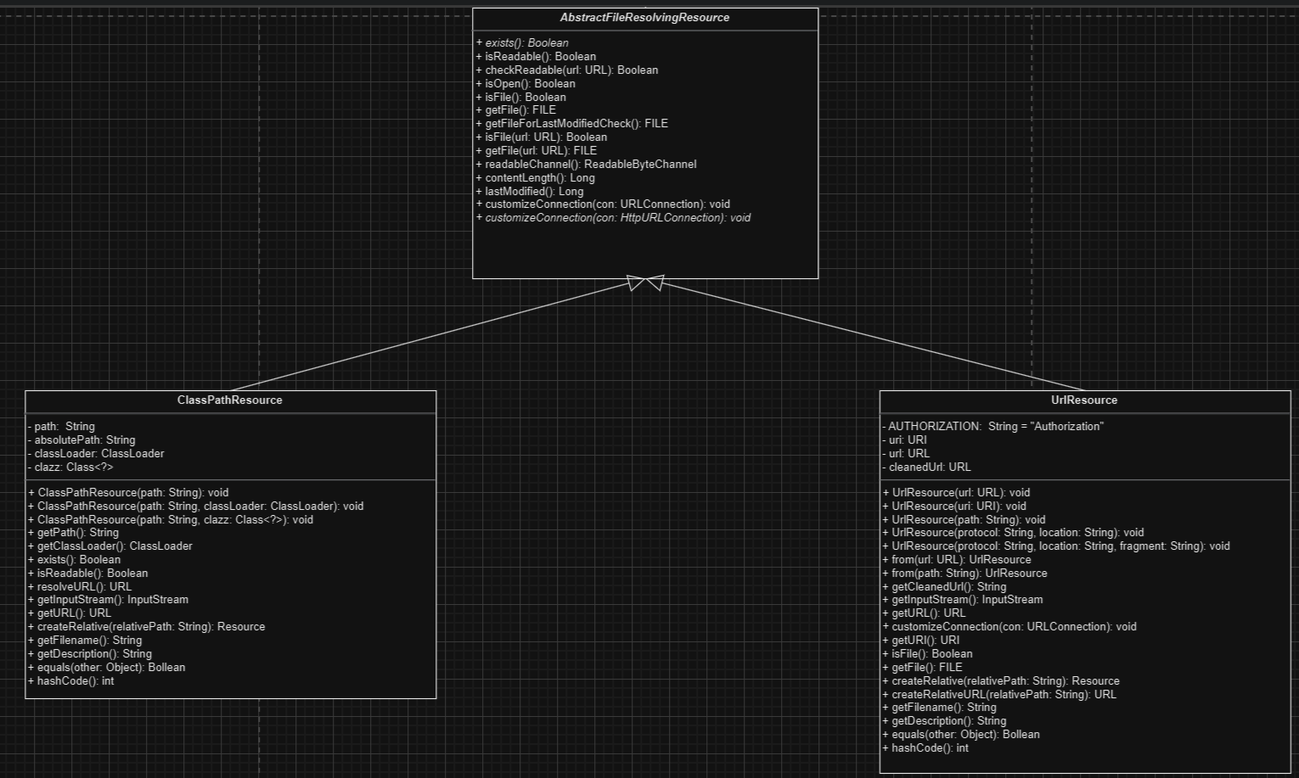
許庭瑋
Notes:
ConvertingComparator<S, T>, DefaultConversionService, 8 default converters

Slide 21
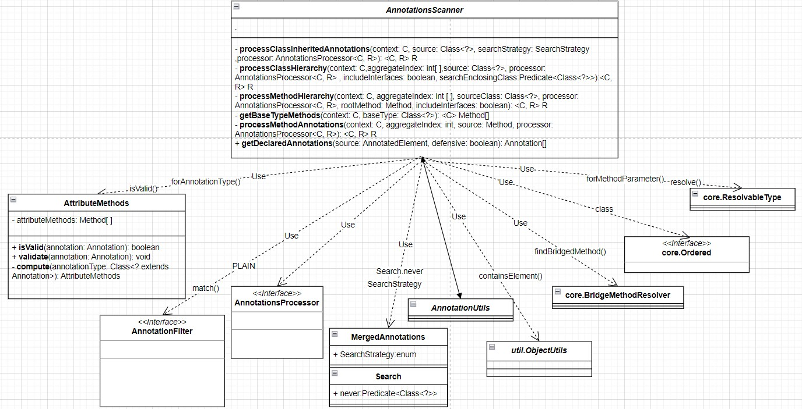
楊昕叡

Slide 22
劉玠均
DefaultConversionService (class diagram full version)
Default converters (W4)
Collection converters (W5)
Scalar converters, AbstractConditionalEnumConverter (W6)
ConvertingComparator
Notes:
ConvertingComparator<S, T>, DefaultConversionService, 8 default converters

Slide 23
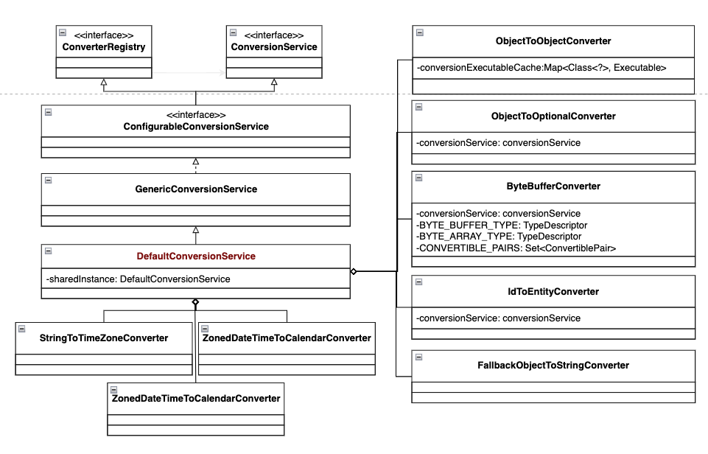

Slide 24
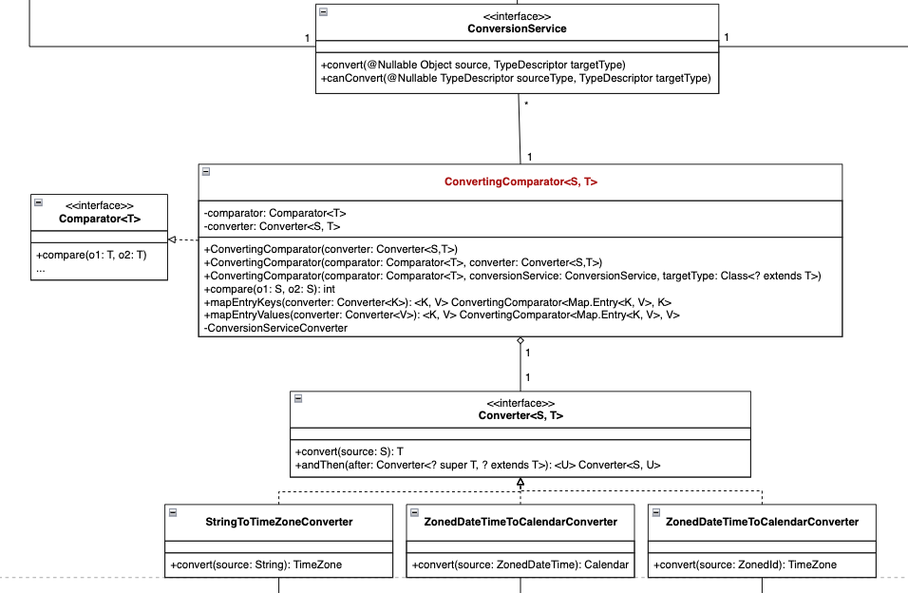
DefaultConversionService
(previous page)

Slide 25
洪世彬
The Decoder<T> defines an interface for decoding DataBuffer into an object.
It defines two methods: one for decoding into a Flux and another for decoding into a Mono.

Slide 26
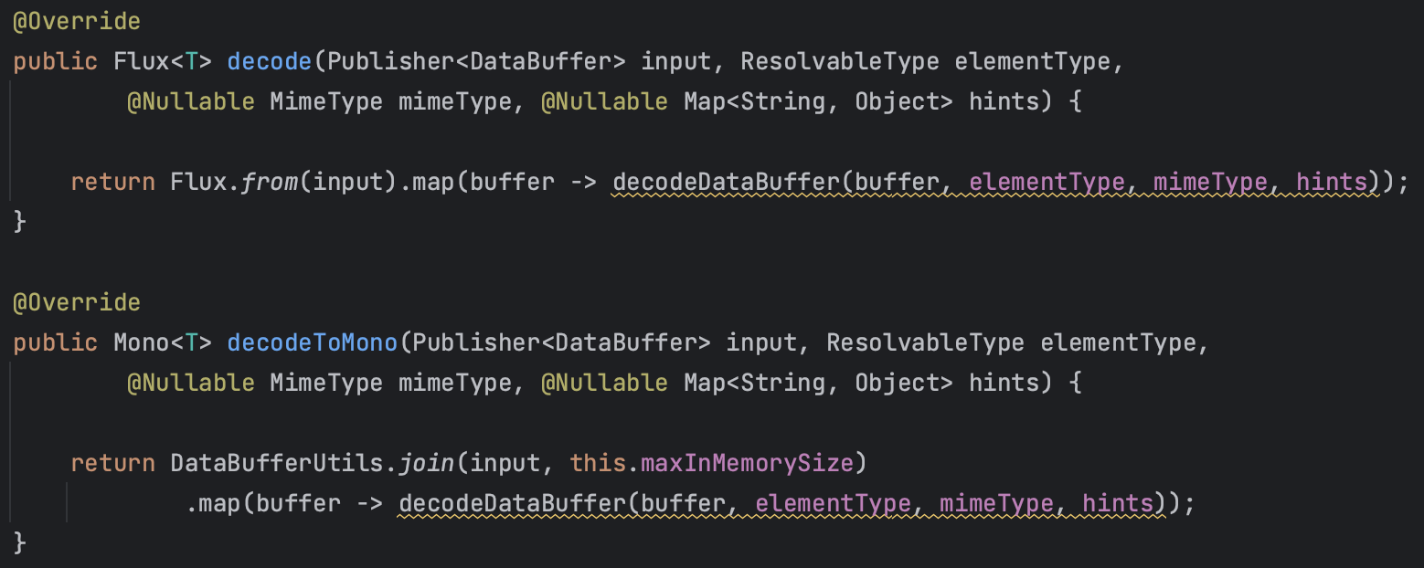
洪世彬
There is a difference compared to the Encoder. The Decoder introduces an additional layer of abstraction, which implements the two decode types mentioned above, and delegates the actual decoding process to the child classes.

Slide 27
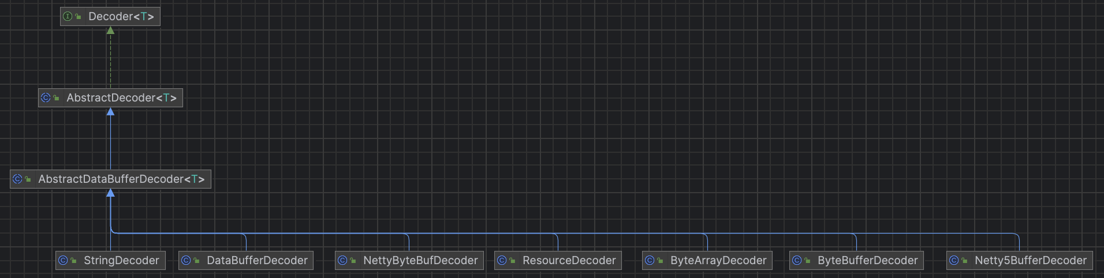
洪世彬
The decoder also has various implementations to handle different types of input.

Slide 28
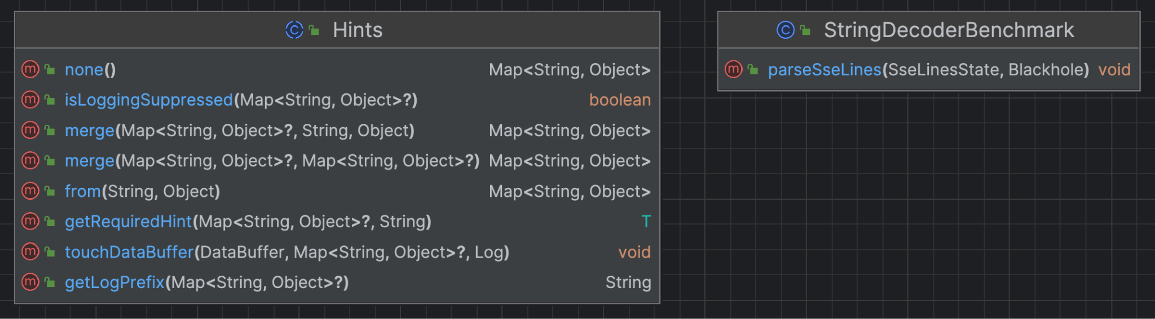
洪世彬
In the codec package, there are two remaining classes: "Hints" and "StringDecoderBenchmark". "Hints" is related to handling logging, while "StringDecoderBenchmark" is a class used for benchmarking DataBufferUtils.

Slide 29
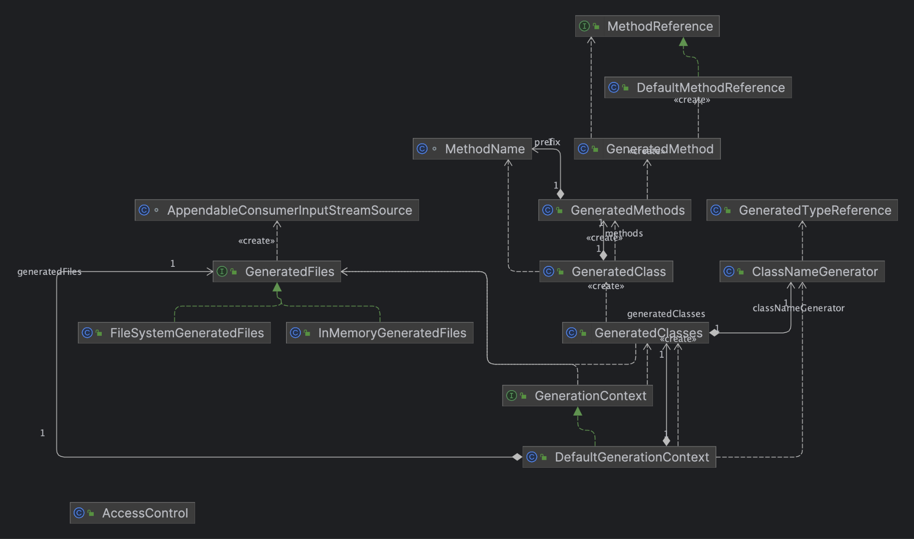
陳君翰

Slide 30
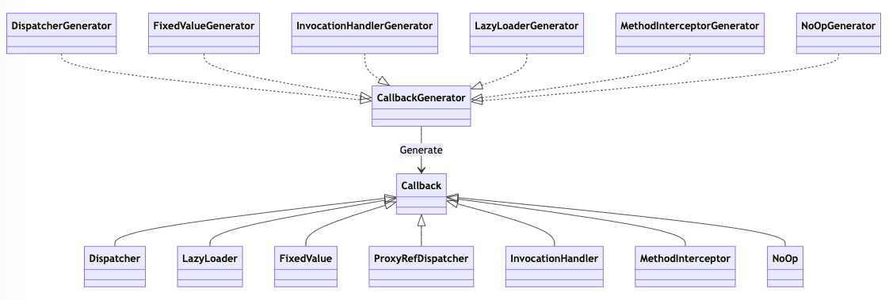
林俊佑
Callback Component
現有理解 for Proxy

Slide 31
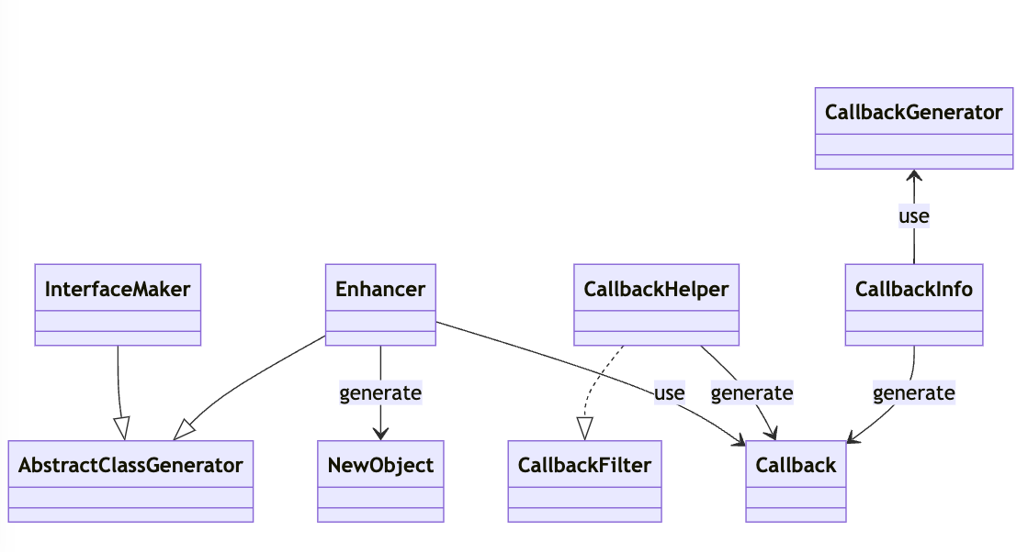
林俊佑
Proxy (去掉部分組件)
現有理解 for Proxy

